Slide 1
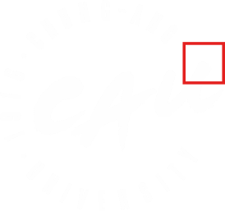

2024 Annual Report - AXIS Lab
Dongchan KIM
December 26, 2024
CAU HEP Center Workshop, Hyundai Bloomvista

Slide 2
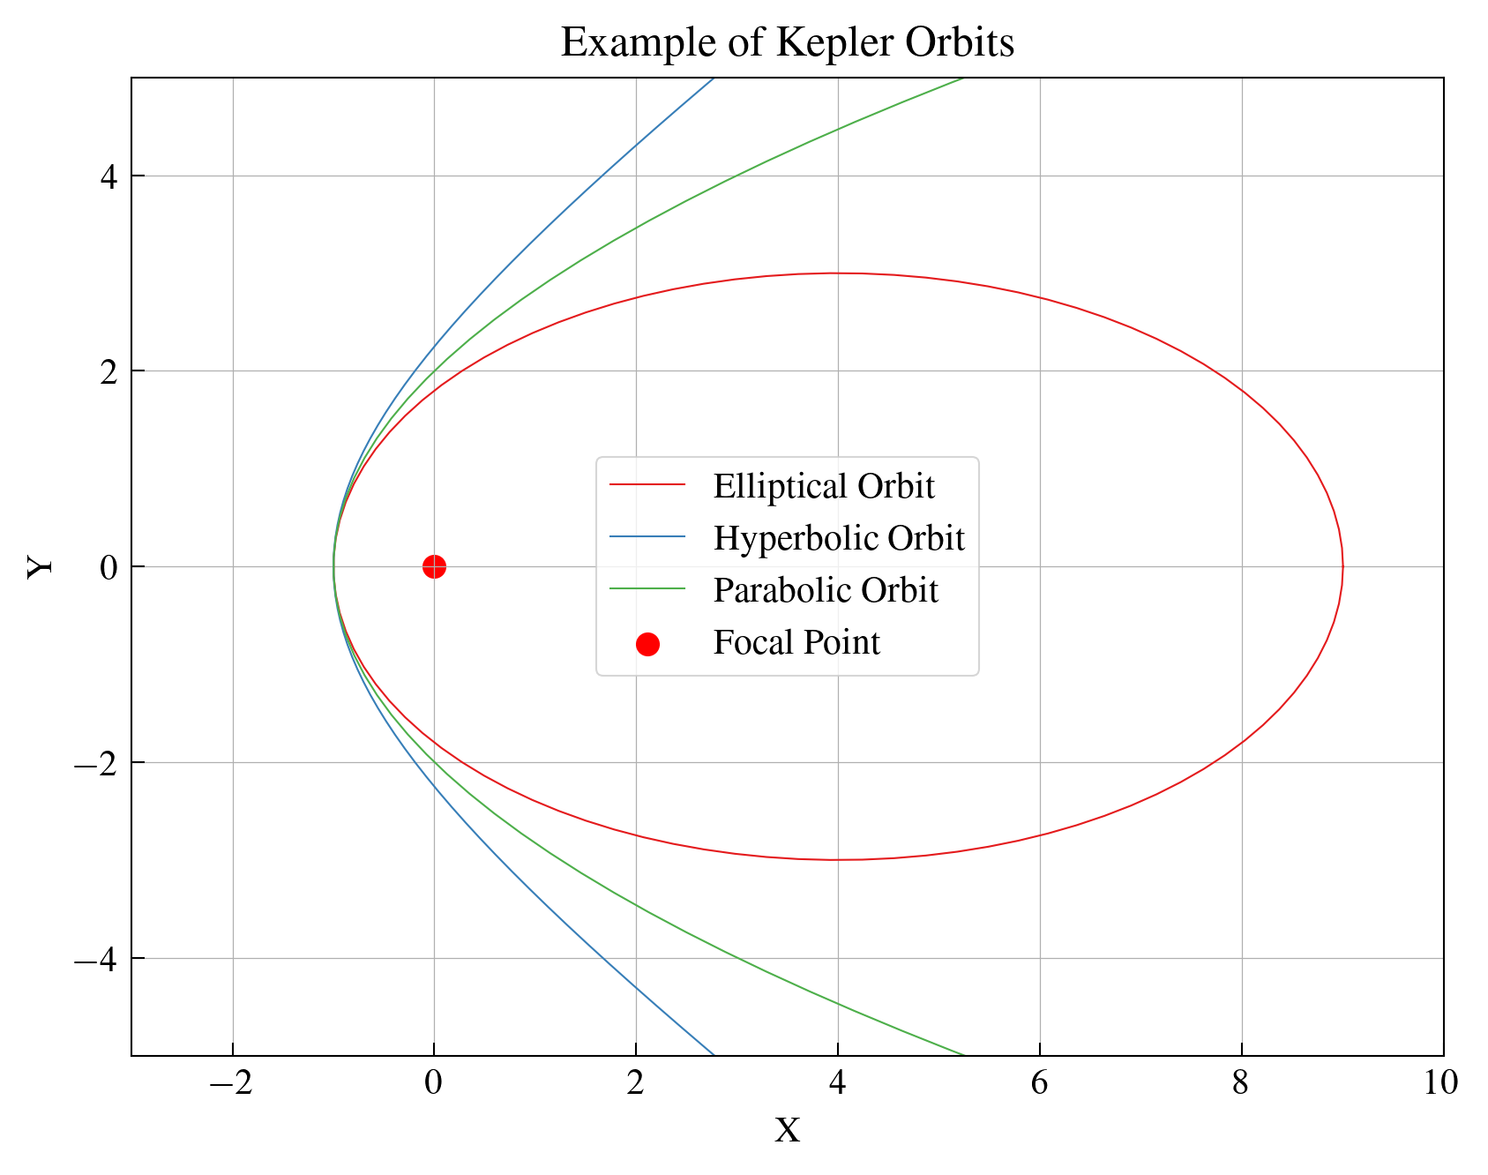
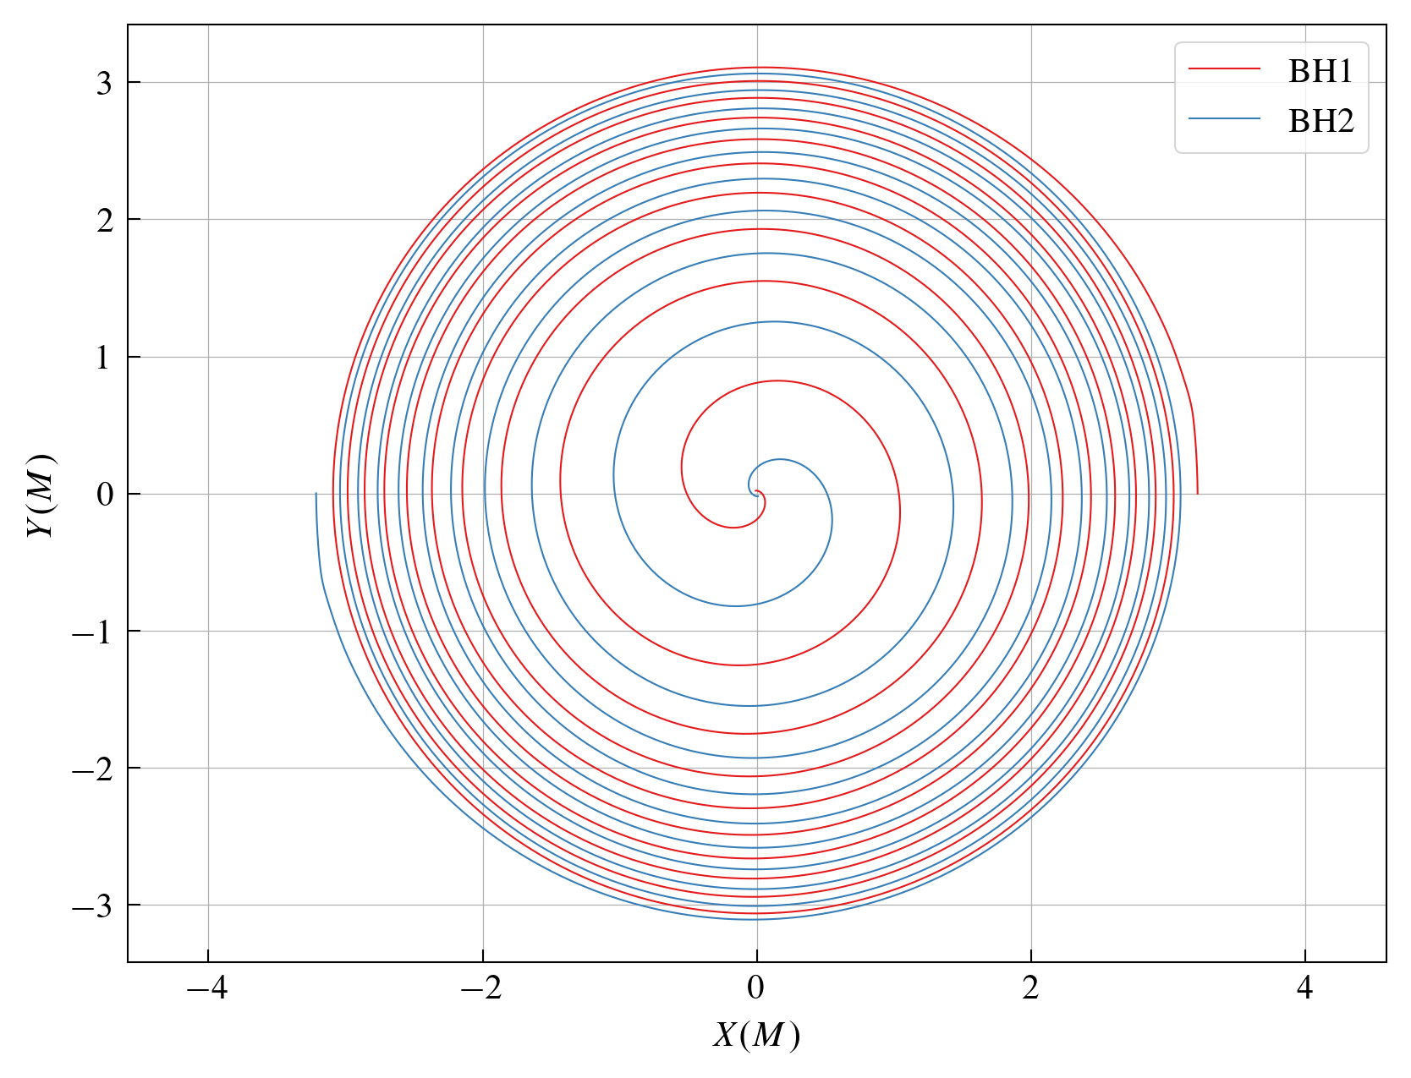
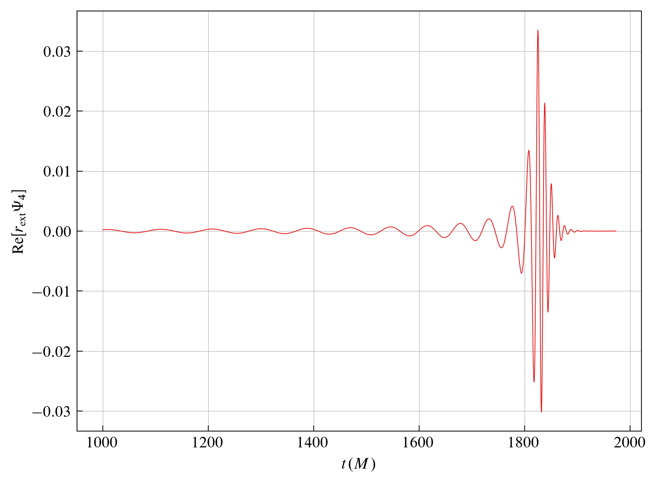
What Do We Study?
There are various orbits depending on the eccentricity.

Slide 3
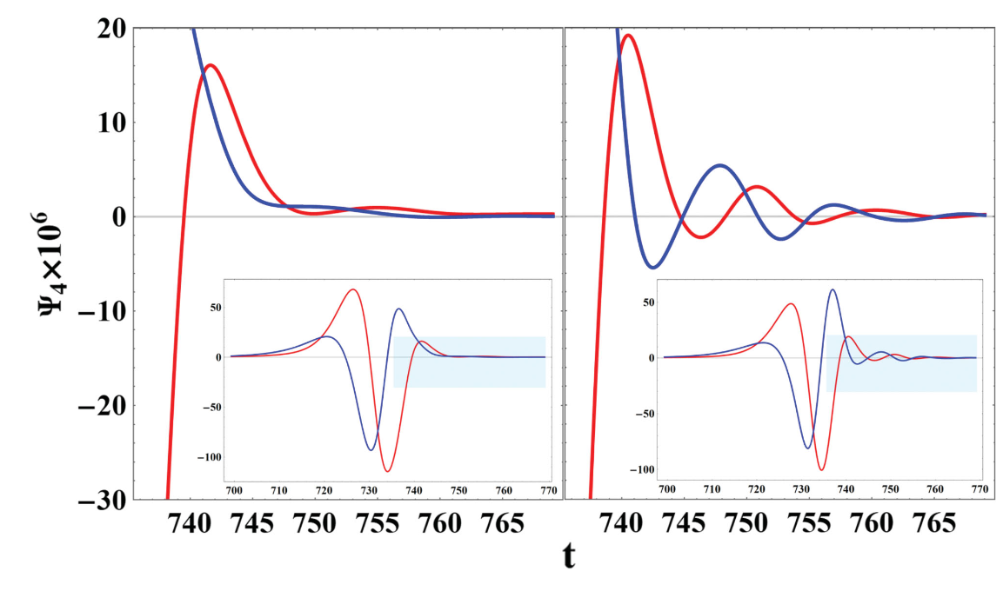
Studies on High-Eccentricity Orbits
NR Result
Gravitational waves from scattering orbits with high eccentricity exhibit different characteristics compared to those from quasi-circular orbits.
[Bae et al. 2024]

Slide 4
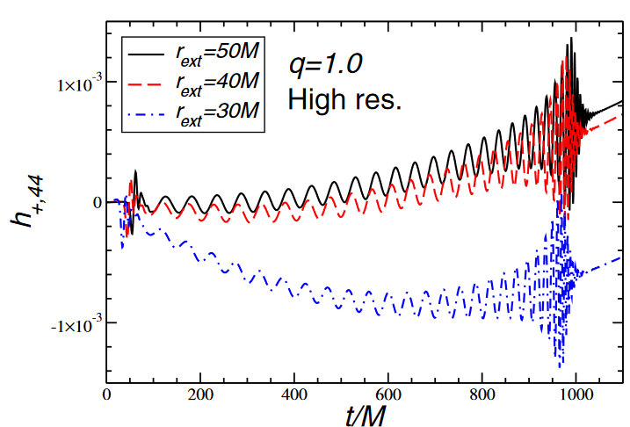
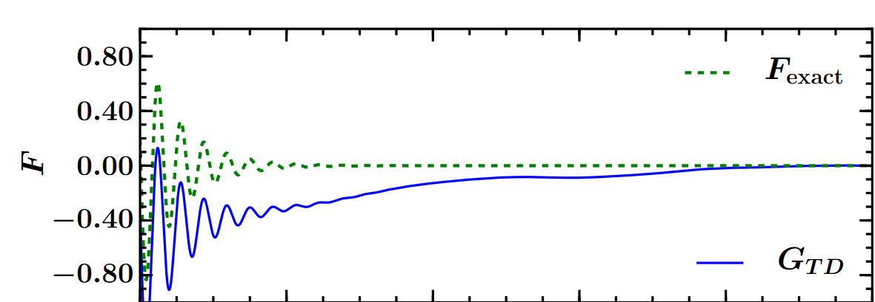
Integration of Gravitational Waveforms
Nonlinear Drift
We numerically obtain the values for $\overset{··}{h}$, and by integrating these values, we can calculate the GW strain $h$.
During this process, nonlinear drift occurs.
[Reisswig et al. 2011]
[Berti et al. 2007]

Slide 5
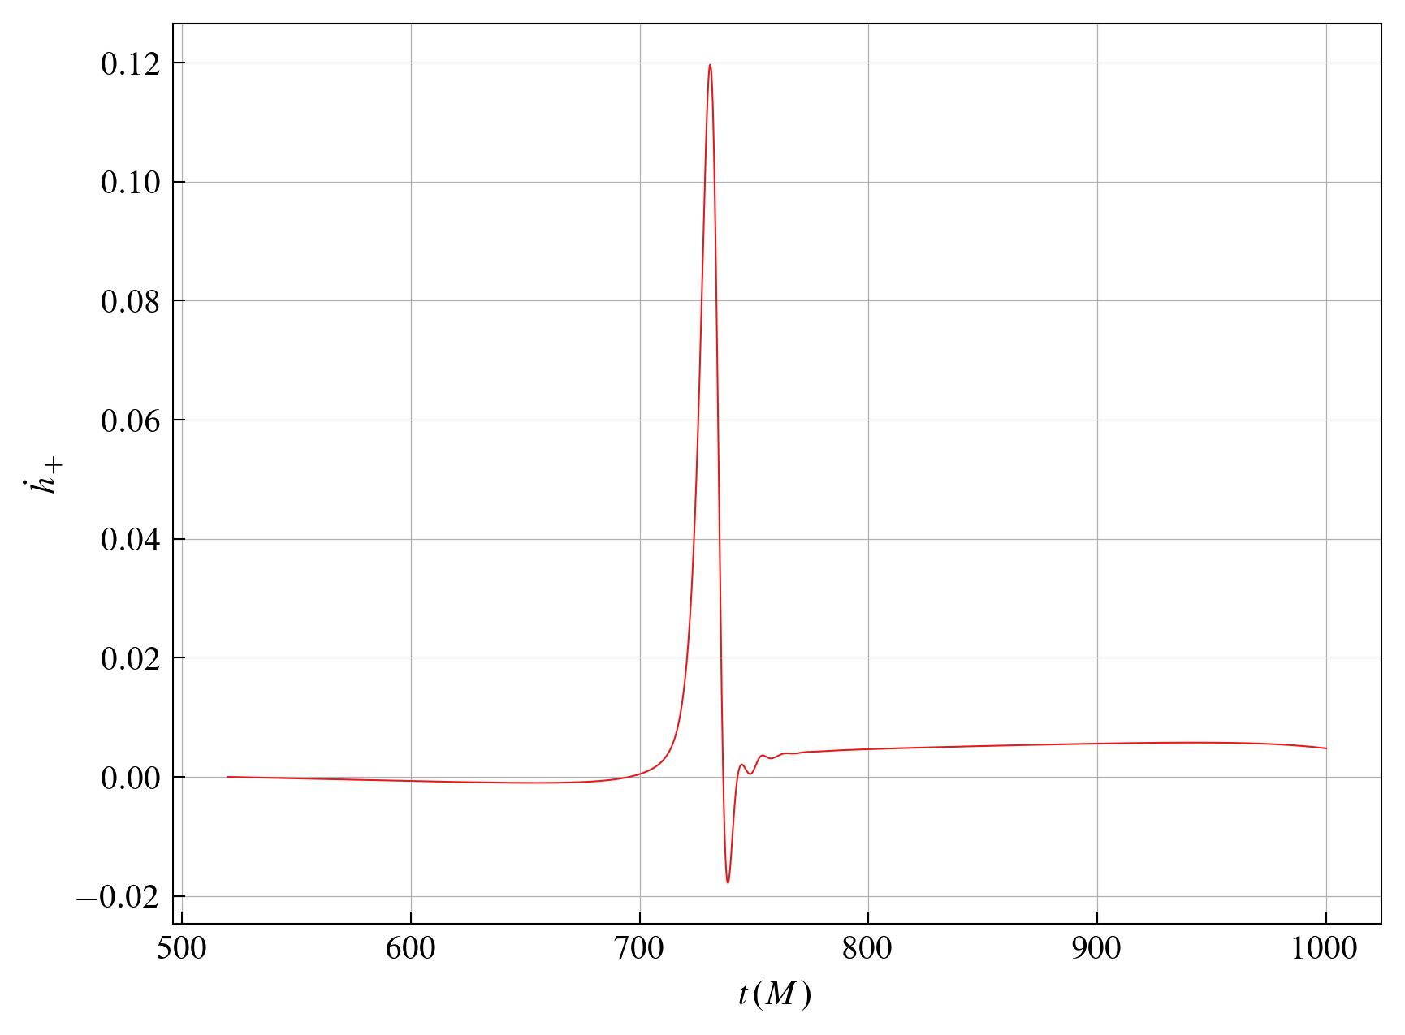
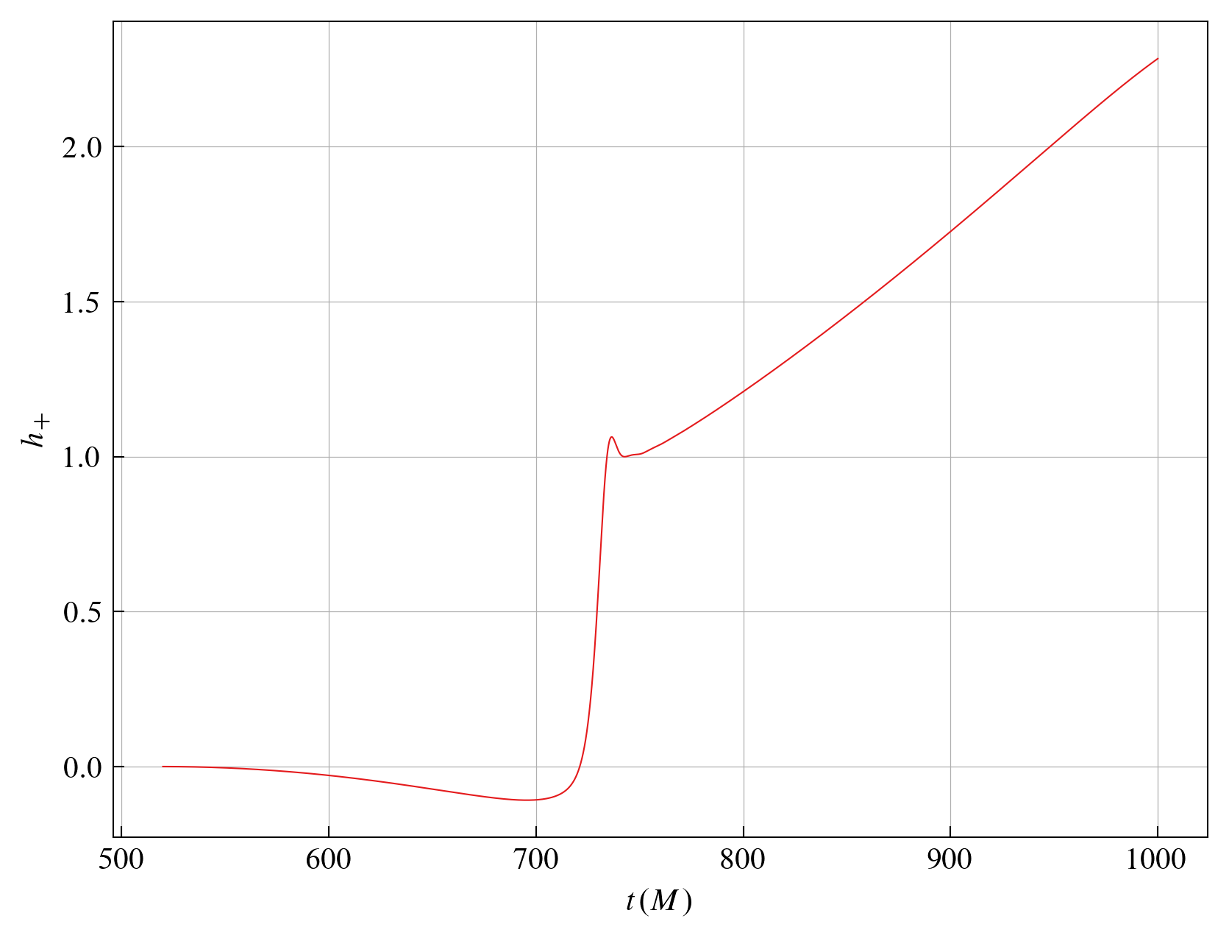
Integration of Gravitational Waveforms
Nonlinear Drift
[Reisswig et al. 2011] addressed this issue using FFI, but it could only be applied to GWs from quasi-circular orbits. ([Hopper et al. 2023])

Slide 6
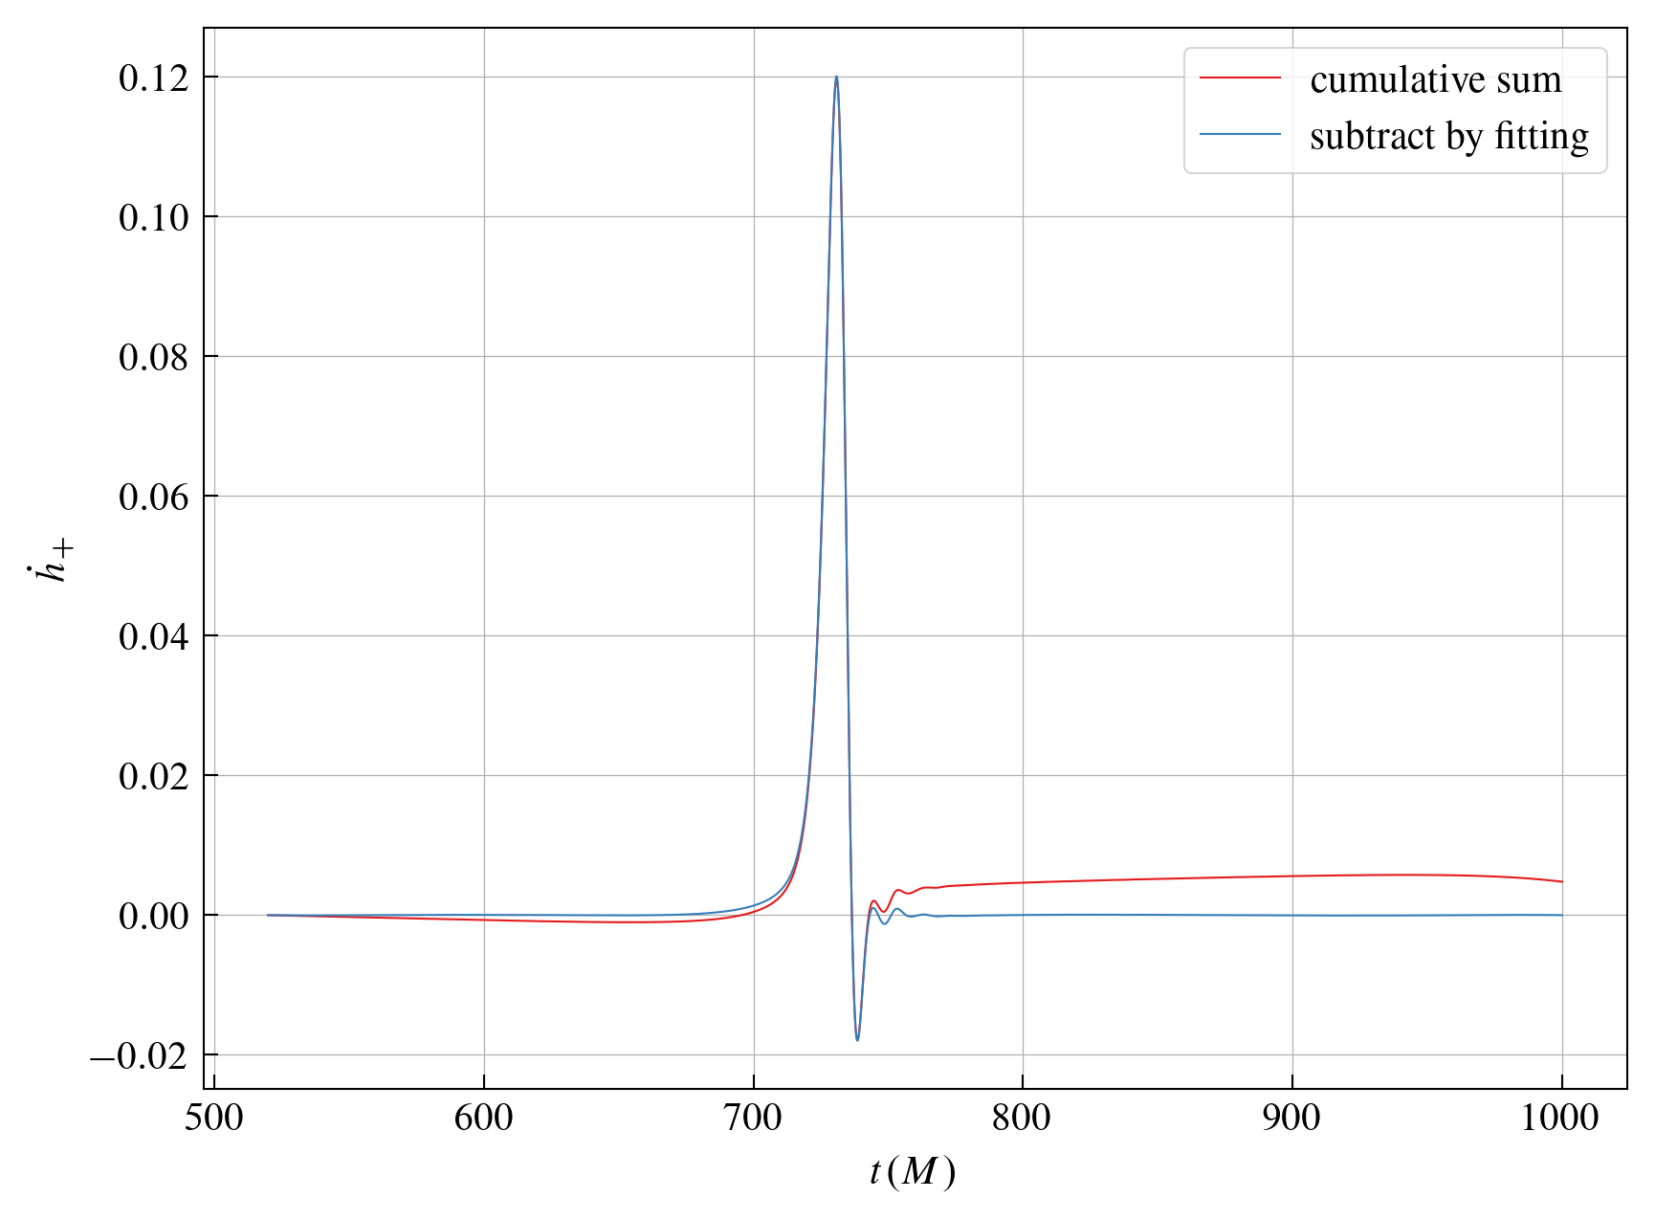
Integration of Gravitational Waveforms
Nonlinear Drift
We minimized the drift in $\overset{·}{h}$ by fitting a polynomial function to the background noise and subtracting it from the waveform.

Slide 7
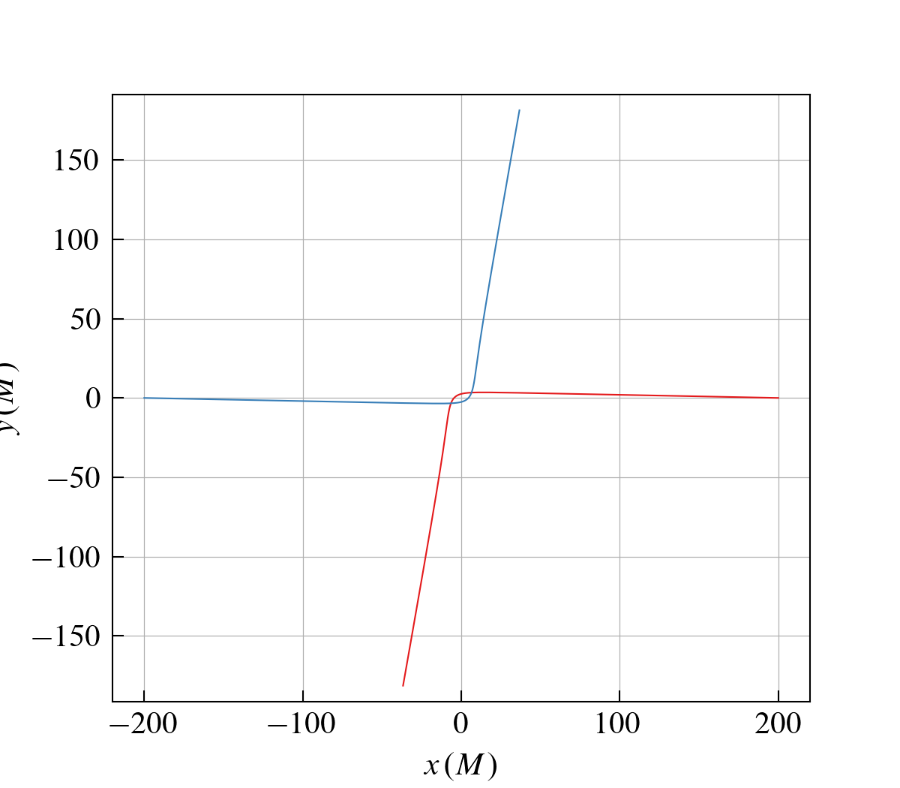
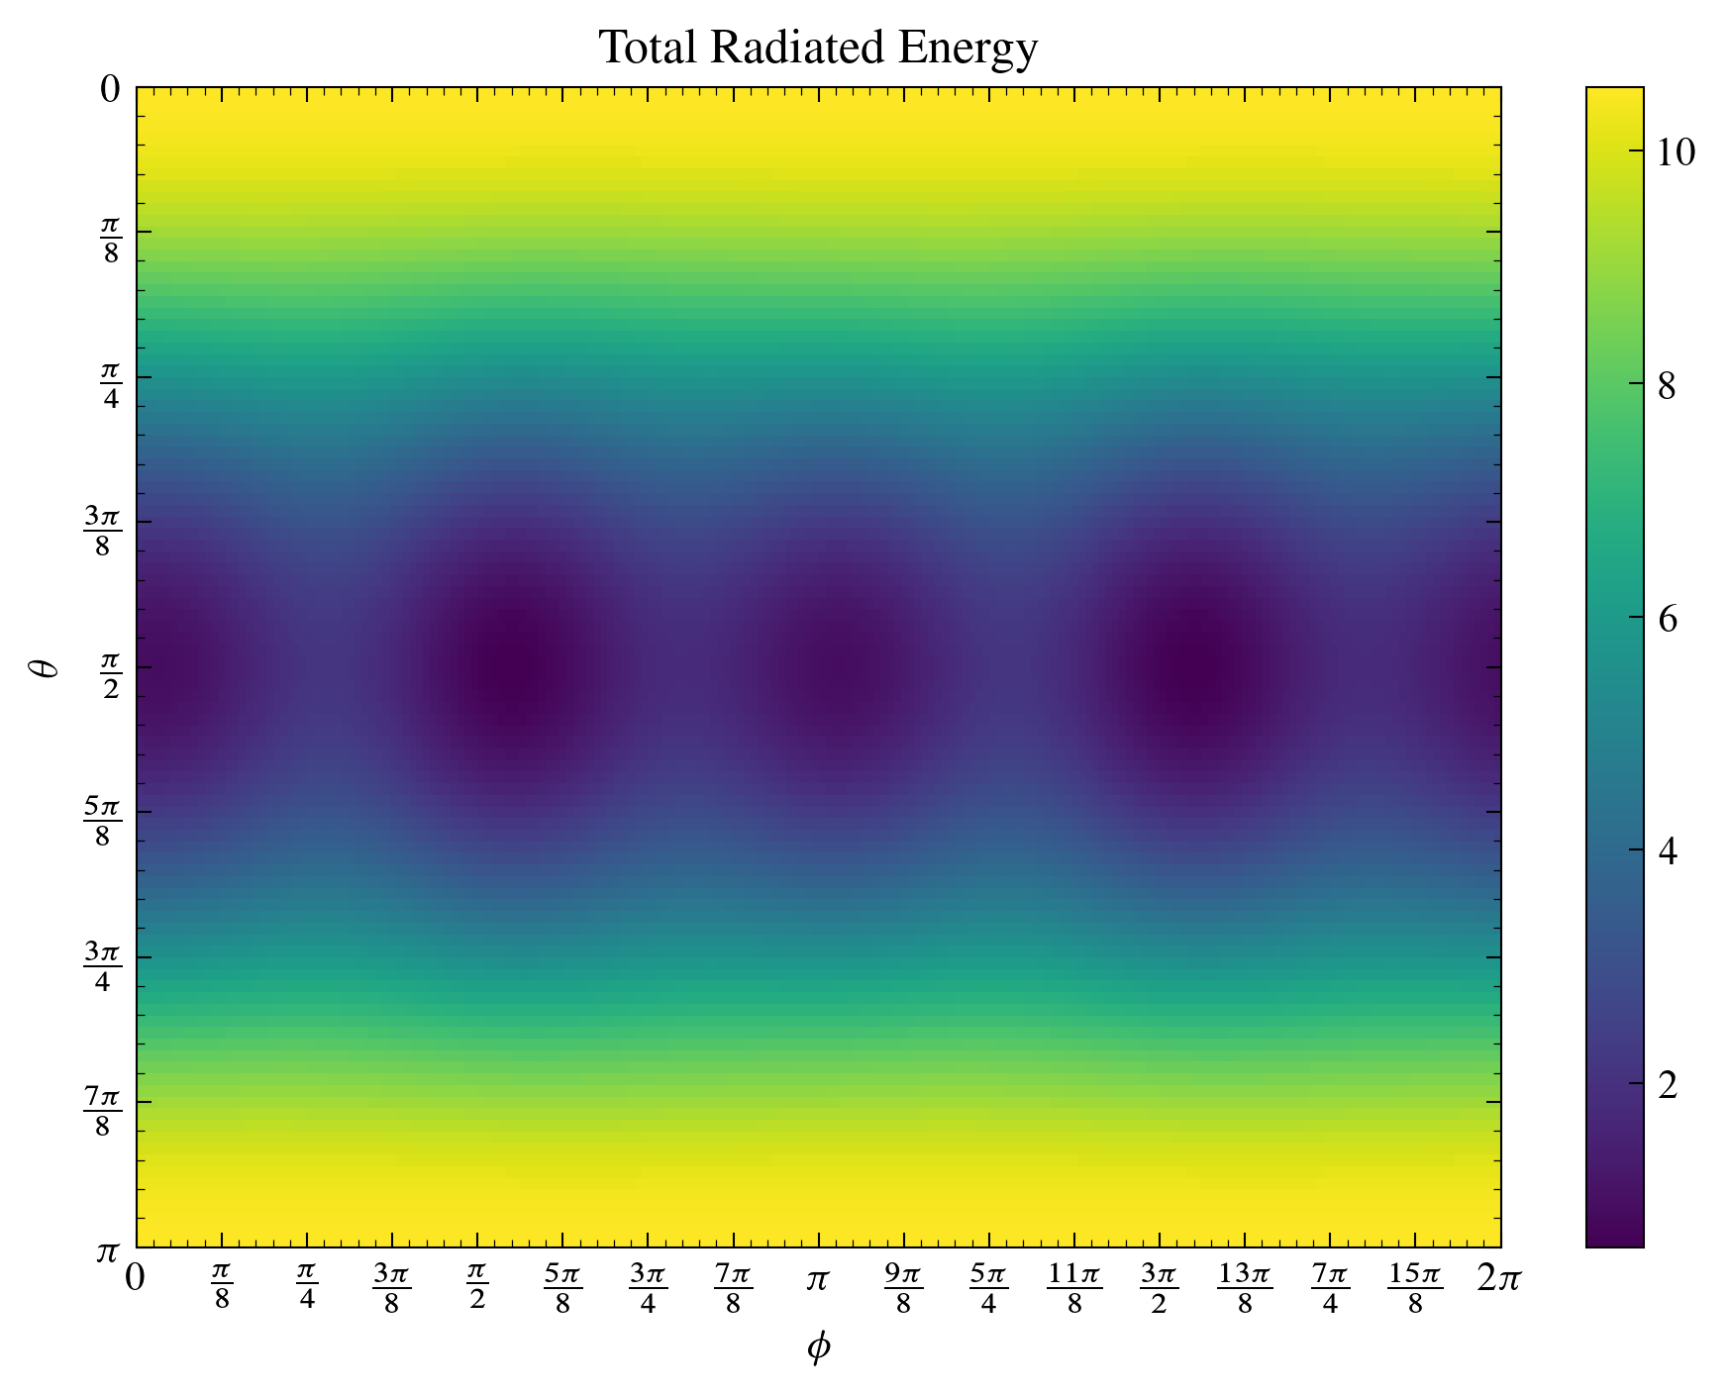
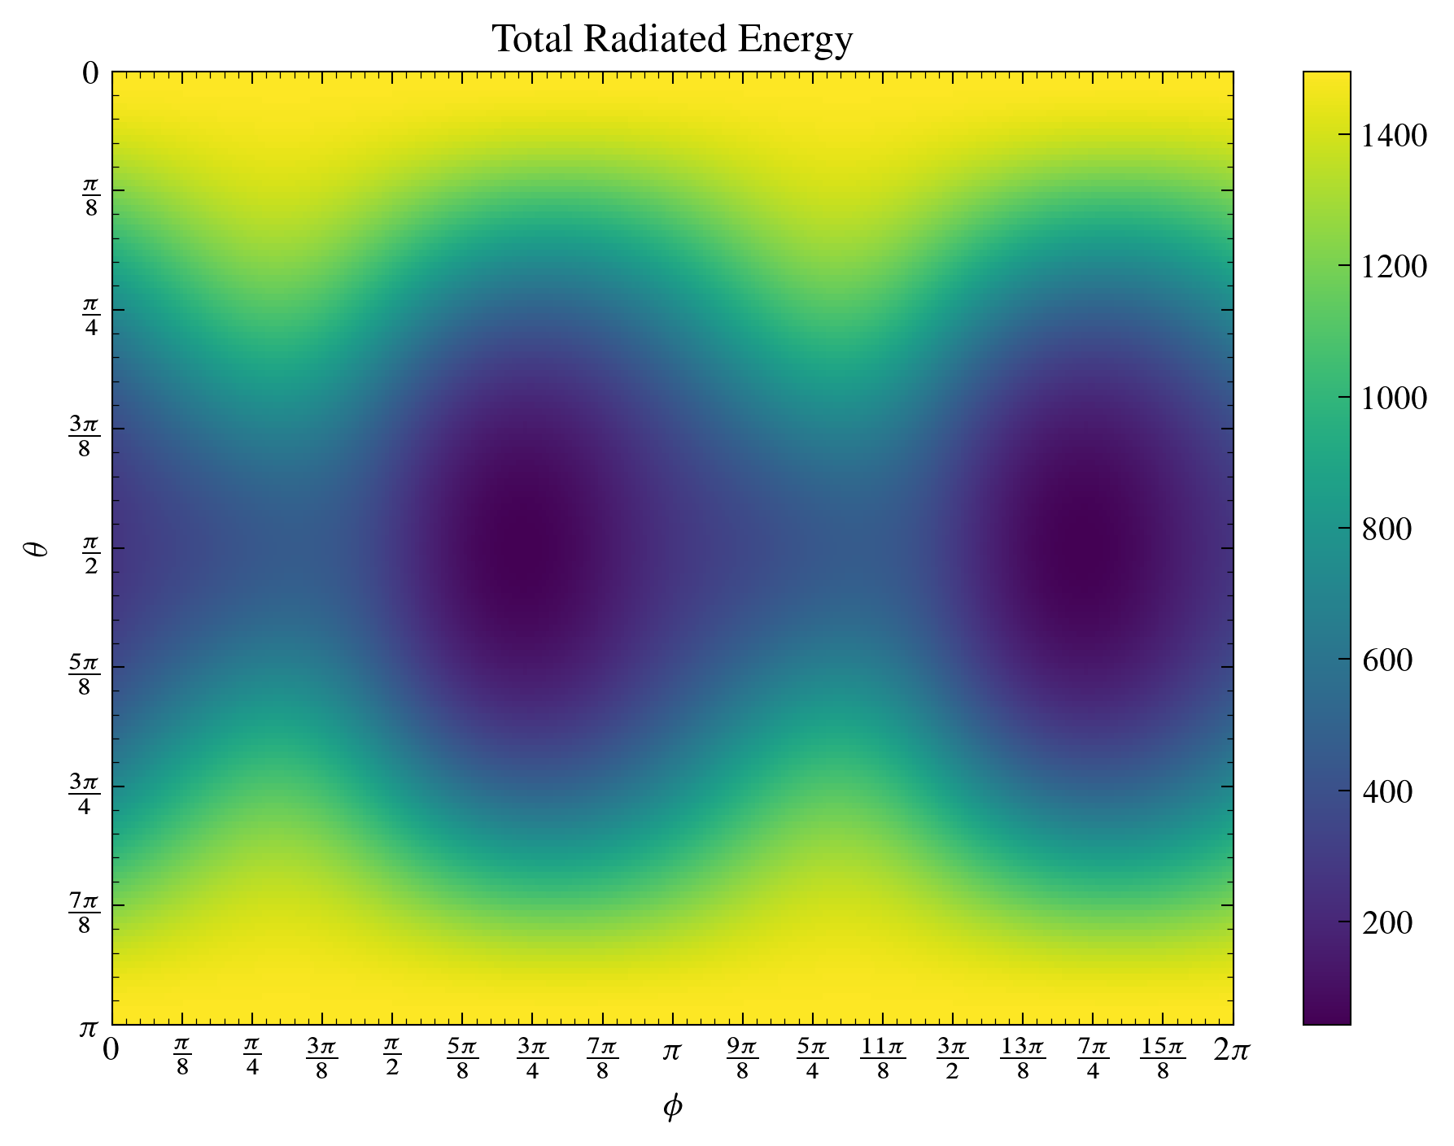
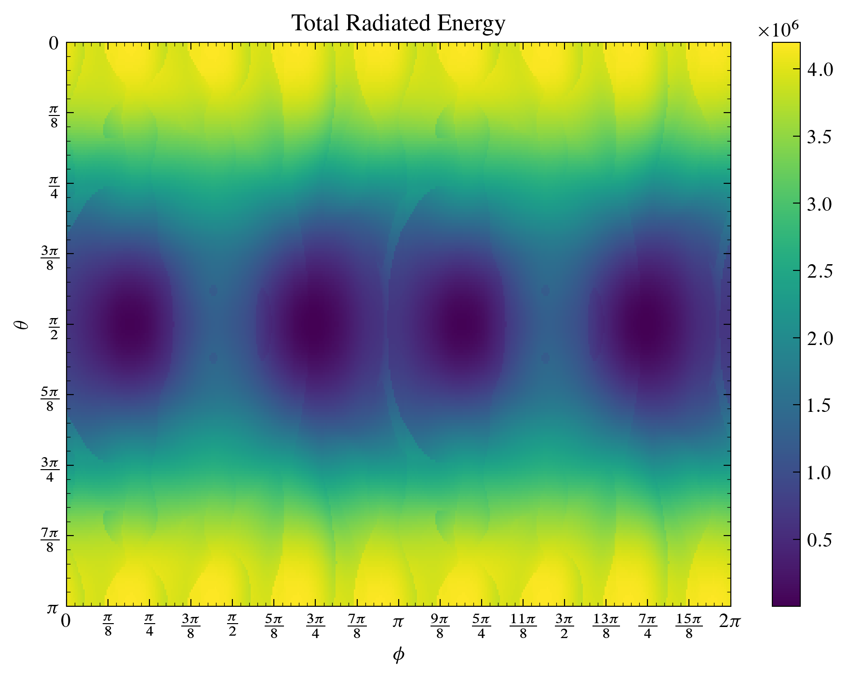
Integration of Gravitational Waveforms
Radiated Energy
The energy radiated can be calculated from $\overset{·}{h}$.

Slide 8
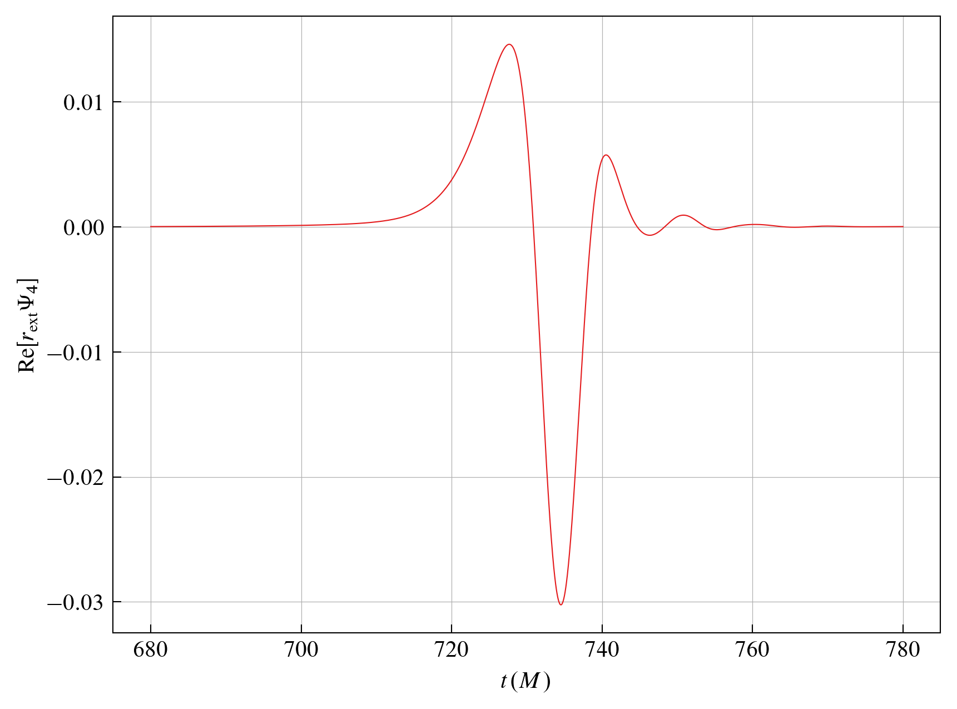
Differences in TD and RD Waveforms
Trajectory Driven (TD) waveforms and Ringdown (RD) waveforms are expected to exhibit different characteristics depending on the extraction radius, as they originate from different sources.

Slide 9
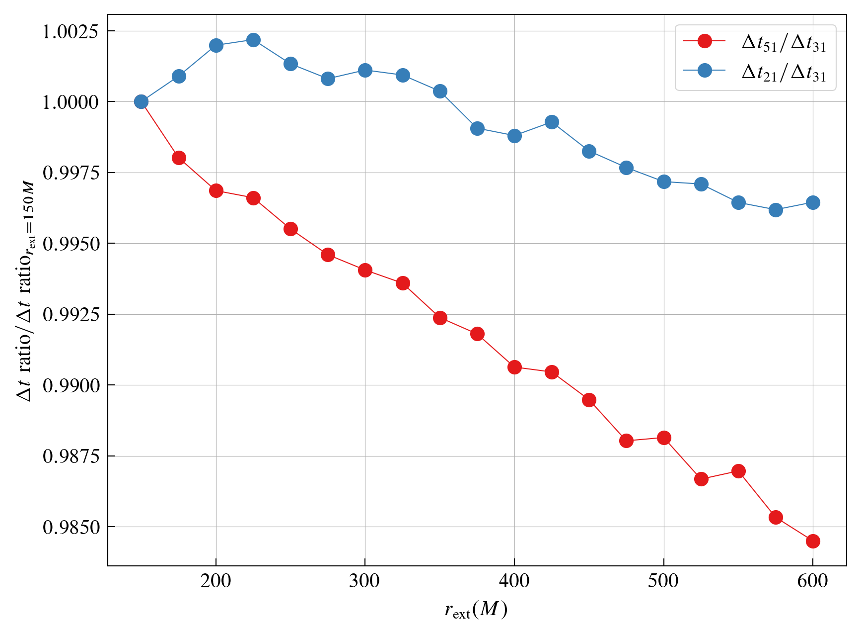
Differences in TD and RD Waveforms

Slide 10
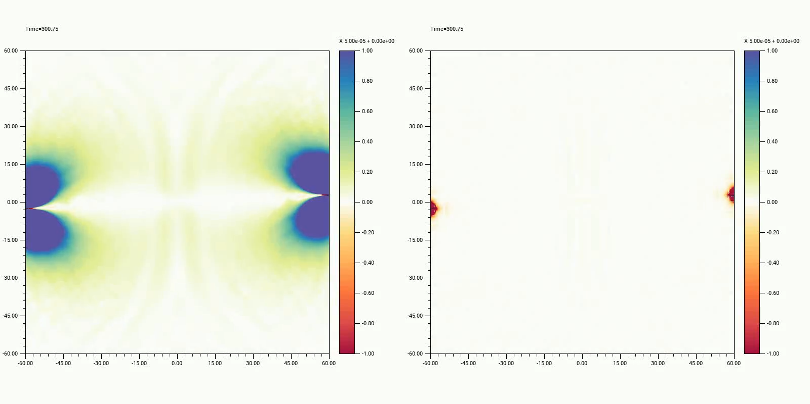
Psi4 Visualization
$Ψ_{4}$ on the xy-plane was calculated and visualized. A mean filter was applied to better observe the waveforms in regions with strong fields.

Slide 11
Future Research
Develop Integration of psi4
Spin + Unequal Mass Hyperbolic Encounter
Multiple Black Holes Simulations

Slide 12
Academic Activities
Contribution Talks
2024 Summer KGWG (2024. 7. 22)
Topic: Characterizing Gravitational Waves from the Hyperbolic Encounter of Two Black Holes
2024 Fall KPS (2024. 10. 23)
Topic: Interference of Ringdown Gravitational Waves from the Hyperbolic Encounter of Two Black Holes
73rd GWNR Workshop (2024. 11. 26)
Topic: Characterizing Gravitational Waves from the Hyperbolic Encounter of Two Black Holes

Slide 13
Thank you!

